Slide 1
End-to-End CI/CD Pipeline on AWS with Jenkins, GitHub, Maven, Docker, ECR, and Kubernetes for Java Web App Deployment
Manaswini
July 2025

Slide 2
TABLE OF CONTENT
Problem Statement
Tools Used
Steps or Phases in Project
Phase 1: CI/CD with GitHub, Jenkins, Maven & Tomcat
Phase 2: CI/CD with Docker Integration
Phase 3: Push Docker Image to AWS ECR & Deploy to Kubernetes
Phase 4: Final Deployment & Validation
Result and Discussion

Slide 3
Problem Statement
Create an end to end CI/CD pipeline in AWS platform using Jenkins as the orchestration tool, Github as the SCM, Maven as the Build tool, Deploy in a docker instance and create a Docker image, Store the docker image in ECR, Achieve Kubernetes deployment using the ECR image. Build a sample java web app using maven.

Slide 4
Tools Used
Git- Tracks code changes locally; version control system
GitHub- Hosts code repositories online; enables collaboration and integration.
Jenkins- Automates build, test, and deployment; core of the CI/CD pipeline.
Maven- Builds Java projects; manages dependencies and packaging.

Slide 5
Tools Used
Tomcat- Deploys Java web apps; lightweight application server.
Docker- Containerizes applications; ensures consistent environments.
AWS ECR- Stores Docker images securely; used for Kubernetes deployments.
Kubernetes (EKS)- Manages containers at scale; automates deployment and scaling.

Slide 6
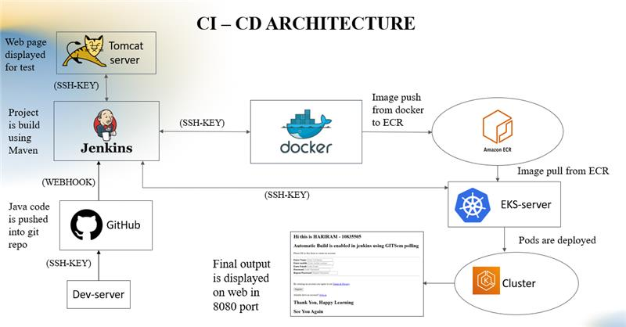
System Architecture

Slide 7
Steps or Phases in Project
Phase 1: CI/CD with GitHub, Jenkins, Maven & Tomcat
Phase 2: CI/CD with Docker Integration
Phase 3: Push Docker Image to AWS ECR & Deploy to Kubernetes
Phase 4: Final Deployment & Validation

Slide 8
Phase 1: CI/CD with GitHub, Jenkins, Maven & Tomcat
Set up Jenkins and install required plugins.
Configure Maven and Git in Jenkins.
Connect Jenkins to GitHub to pull code.
Build Java app using Maven.
Deploy the WAR file to Tomcat server.
Test the deployment via browser.

Slide 9
Phase 2: CI/CD with Docker Integration
Install Docker on Jenkins host.
Write a Dockerfile to containerize the Java app.
Build Docker image using Jenkins.
Run the container and expose the app.
Automate the entire process in Jenkins pipeline.

Slide 10
Phase 3: Push Docker Image to AWS ECR & Deploy to Kubernetes
Create an ECR repository in AWS.
Authenticate Docker with AWS CLI.
Push Docker image to ECR.
Set up EKS (Elastic Kubernetes Service).
Write Kubernetes deployment and service YAML files.
Deploy app using ECR image in Kubernetes.

Slide 11
Phase 4: Final Deployment & Validation
Trigger Jenkins pipeline to build and deploy.
Validate pod creation in Kubernetes.
Get service IP using kubectl get svc.
Access the app in browser using service IP.
Confirm successful end-to-end deployment.

Slide 12
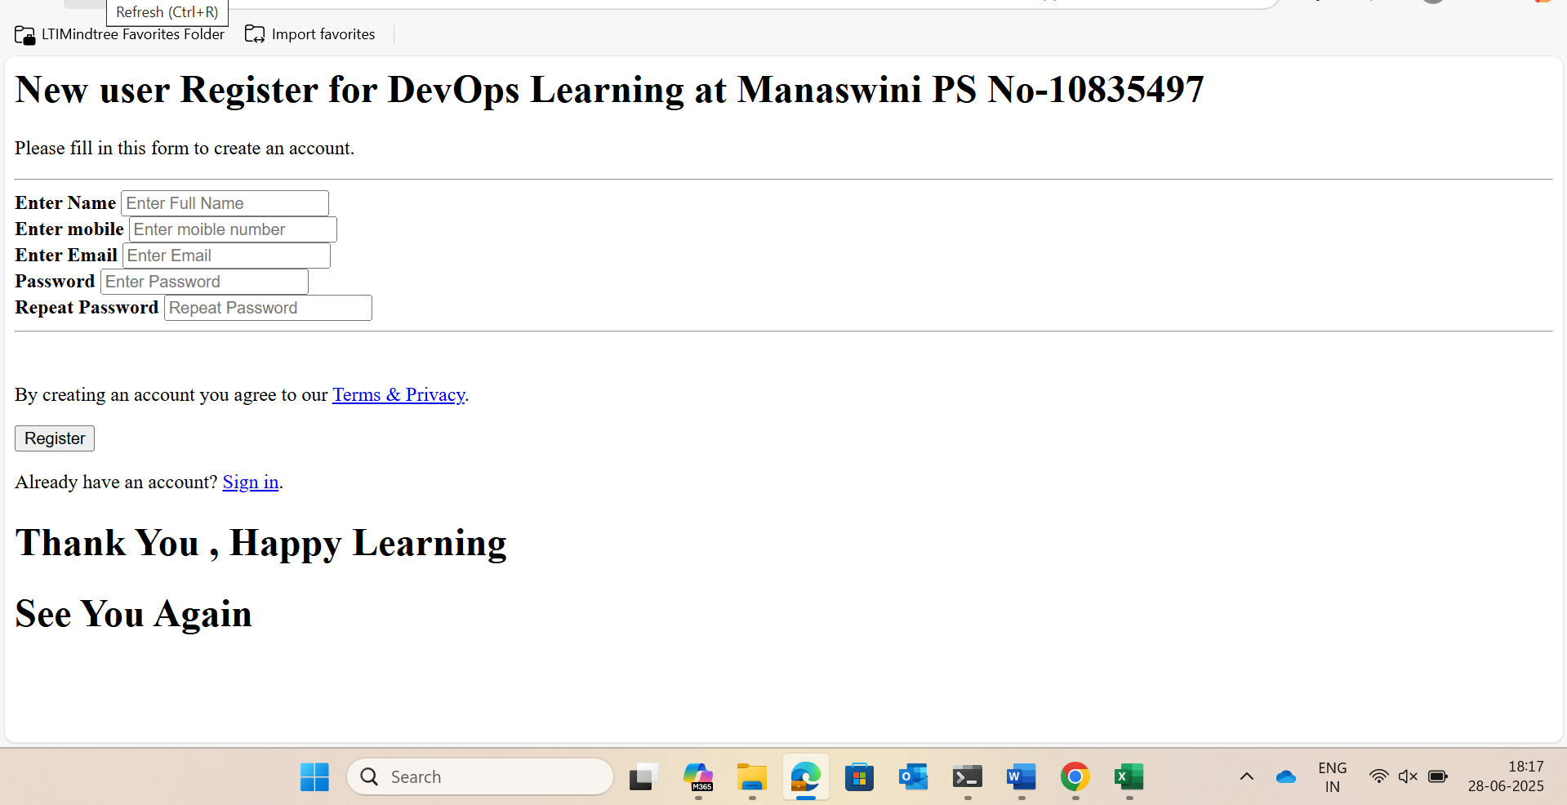
Results and Discussion

Slide 13
Thank You!!

